Slide 1
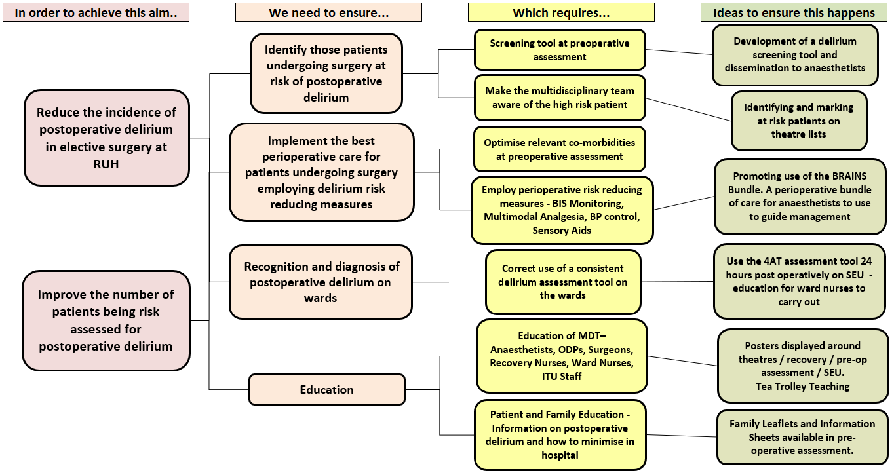
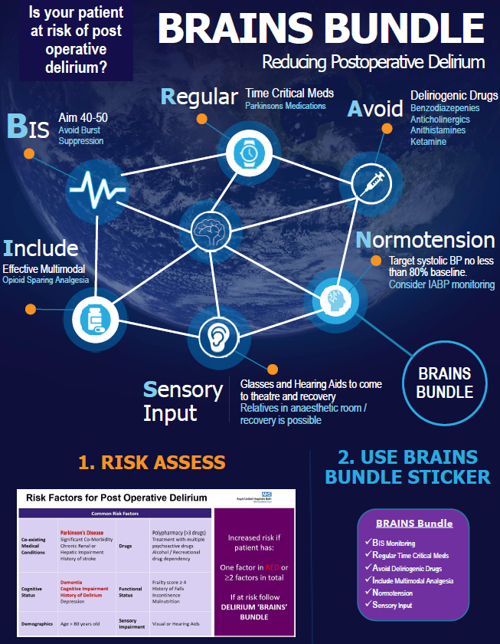
BRAINS Bundle
BIS Monitoring
Regular Time Critical Meds
Avoid Deliriogenic Drugs
Include Multimodal Analgesia
Normotension
Sensory Input
The BRAINS Bundle: a new pre-operative risk assessment tool and intra-operative bundle to help prevent postoperative delirium
Dr D Choudhuri, Dr R Awan, Dr L Jordan
Royal United Hospitals Bath NHSFT, Department of Anaesthesia
Introduction
Postoperative delirium (POD) is an acute alteration of mental status occurring after surgery. It contributes to patient morbidity, increases length of stay, distress and mortality. Incidence ranges from 10-50% but up to 40% of cases may be preventable.¹ Locally, baseline data showed poor documentation of preoperative risk assessment for patients developing POD. Our aim was:
to improve awareness of POD and specifically increase recognition of patients at risk of POD at preoperative assessment and identification of delirium postoperatively
improve perioperative management of these patients to reduce incidence of POD .
Methods
Patients aged over 65 undergoing major colorectal surgery were chosen as the pilot group to study. Baseline data was collected for 16 patients which found no preoperative documentation of POD risk and no reliable assessment of POD postoperatively. One (6%) of these patients had POD documented, but the incidence may have been higher as assessment was absent in the other patients.
A multidisciplinary group was established including care of the elderly physicians and a driver diagram (Figure 1) was created to help guide interventions. A literature review was conducted to help create a POD risk assessment tool as well as an evidence based innovative perioperative bundle (BRAINS bundle) for anaesthetists to use in POD prevention. These two tools were agreed with the care of elderly physicians, tested on a small number of patients and amendments made accordingly (Figure 2). Education was given to the anaesthetic department, with further tea trolley small group training planned and the tools introduced for use on patients undergoing colorectal surgery.
Nurses on the postoperative surgical ward were given teaching on the 4AT assessment tool and asked to use this on day 1 postoperatively for those patients aged over 65. Following the roll out of interventions we measured compliance with delirium risk assessment preoperatively and with elements of the BRAINS bundle in these patients. Unfortunately the Covid Pandemic commenced immediately after so number of patients evaluated was small.
Figure 1. Driver Diagram created to help guide interventions to achieve aims.
Discussion and Conclusions
POSITIVES
Creation of a risk assessment tool and perioperative bundle were well received by anaesthetists and may have influenced improvements in depth of anaesthesia monitoring.
Increasing awareness of POD for ward staff and improved routine 4AT testing. Nurses were very receptive to using this tool on the ward for future patients. Further work to be done to ensure the 4AT score is reliably recorded.
CHALLENGES AND FUTURE WORK
Compliance to bundle difficult to measure for each element and measurable outcomes need to be reassessed.
No real changes in blood pressure control – may need to be a targeted project.
Documented risk assessment still poor – however, the planned tea trolley training was unable to occur due to Covid, which would have reinforced the introduction of the tools: work is ongoing to establish risk assessment at pre-assessment clinic.
Covid pandemic resulted in small numbers reviewed. Further work is planned to study larger numbers of patients to confirm impact of the bundle on incidence of POD and implement reliable processes of pre and postoperative assessment.
Key Results
Following interventions, 8 patients had risk factors for POD. Only 1 (12.5%) was formally documented as high risk for POD on anaesthetic chart. However on inspection of the charts, there was an improvement in BIS targets being adhered to (Figure 3). 50% of patients (4 out of 8) had delirium screening on day 1 postoperatively with no cases of POD found overall post-intervention which was an improvement from the 6% POD rate from our baseline data.
Figure 3 – Intraoperative BIS ranges. Patients 1-16 were from baseline data collection pre-intervention. Patients 17-24 had surgery post interventions. The shaded red area indicates the suggested target BIS range of 40-60. 75% (12 out of 16) of the pre-intervention patients had a BIS <35 compared to only 25% (2 out of 8) in the post intervention group. Improvement was also shown if looking at BIS < 40 with an improvement from 87.5% (14) in the pre-intervention group to 62.5% (5) in the post-intervention group.
Figure 2. Poster created demonstrating risk assessment tool and BRAINS bundle to help guide perioperative management of those at risk of POD.
References
1. Rudolph JL, Marcantonio ER. Review articles: postoperative delirium: acute change with long-term implications. Anesth Analg. 2011;112(5):1202-1211. doi:10.1213/ANE.0b013e3182147f6d

